Slide 1


Slide 2
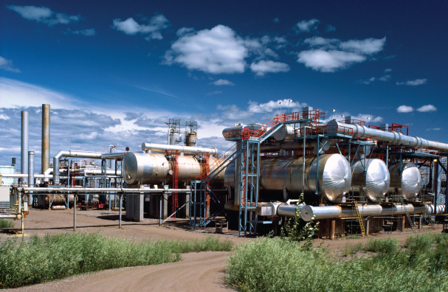
15
EXTERNALITIES

Slide 3
After studying this chapter you will be able to
Explain how externalities arise
Explain why negative externalities lead to inefficient overproduction and the actions that might achieve an efficient outcome
Explain why positive externalities lead to inefficient underproduction and the actions that might achieve an efficient outcome
Copyright © 2013 Pearson Canada Inc., Toronto, Ontario

Slide 4
We burn huge quantities of fossil fuels—coal, natural gas, and oil—that cause acid rain and global warming.
We dump toxic waste into rivers, lakes, and oceans.
These environmental issues are simultaneously everybody’s problem and nobody’s problem.
Everyone benefits from the discoveries of smart scientists and engineers, and from living with other well-educated people.
Do we spend enough on education and research to enjoy enough of these benefits?
Copyright © 2013 Pearson Canada Inc., Toronto, Ontario

Slide 5
Externalities in Our Lives
  An externality is a cost or benefit that arises from production and falls on someone other than the producer, or a cost or benefit that arises from consumption and falls on someone other than the consumer.
  A negative externality imposes a cost and a positive externality creates a benefit.
Copyright © 2013 Pearson Canada Inc., Toronto, Ontario

Slide 6
Externalities in Our Lives
  The four types of externalities are
  Negative production externalities
  Positive production externalities
  Negative consumption externalities
  Positive consumption externalities
Copyright © 2013 Pearson Canada Inc., Toronto, Ontario

Slide 7
Externalities in Our Lives
Negative Production Externalities
  Negative production externalities are common.
  As a bi-product of production, coal-burning power plants and factories dump carbon emissions into the air and chemical plants dump their waste products into the water.
Copyright © 2013 Pearson Canada Inc., Toronto, Ontario

Slide 8
Externalities in Our Lives
Positive Production Externalities
  Positive production externalities are less common than negative externalities.
  A classic example involves bees. The bees in a beekeeper’s hives not only produce honey for the beekeeper to sell but also help pollinate the crops and flowers on neighboring properties.
Copyright © 2013 Pearson Canada Inc., Toronto, Ontario

Slide 9
Externalities in Our Lives
Negative Consumption Externalities
  Negative consumption externalities are a common part of everyday life.
  Smoking in a confined space poses a health risk to others; noisy parties or loud car stereos disturb others.
Copyright © 2013 Pearson Canada Inc., Toronto, Ontario

Slide 10
Externalities in Our Lives
Positive Consumption Externalities
  Positive consumption externalities are also common.
  When you get a flu vaccination, everyone you come into contact with benefits.
  When a homeowner invests in attractive landscaping, everyone who sees the home gets pleasure.
Copyright © 2013 Pearson Canada Inc., Toronto, Ontario

Slide 11
Negative Externality: Pollution
Private Cost and Social Cost of Pollution
  A private cost of production is a cost that is borne by the producer.
  Marginal private cost (MC) is the private cost of producing one more unit of a good or service.
  An external cost of production is a cost that is not borne by the producer but is borne by others.
  Marginal external cost is the cost of producing one more unit of a good or service that falls on people other than the producer.
Copyright © 2013 Pearson Canada Inc., Toronto, Ontario

Slide 12
Negative Externality: Pollution
  Marginal social cost (MSC) is the marginal cost incurred by the entire society—by the producer and by everyone else on whom the cost falls.
  Marginal social cost is the sum of marginal private cost and marginal external cost.
  MSC = MC + Marginal external cost
  We express costs in dollars but remember that the dollars represent the value of a forgone opportunity.
  In practice, marginal external cost increases for most forms of pollution.
Copyright © 2013 Pearson Canada Inc., Toronto, Ontario

Slide 13
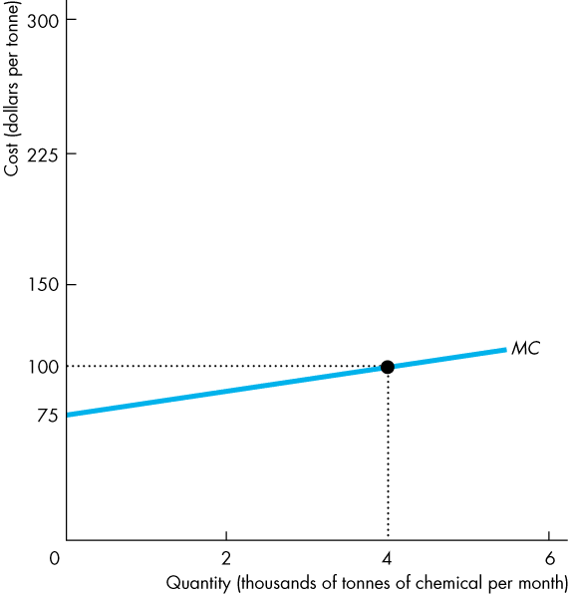
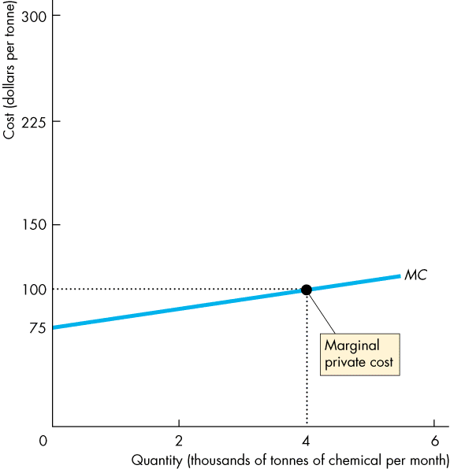
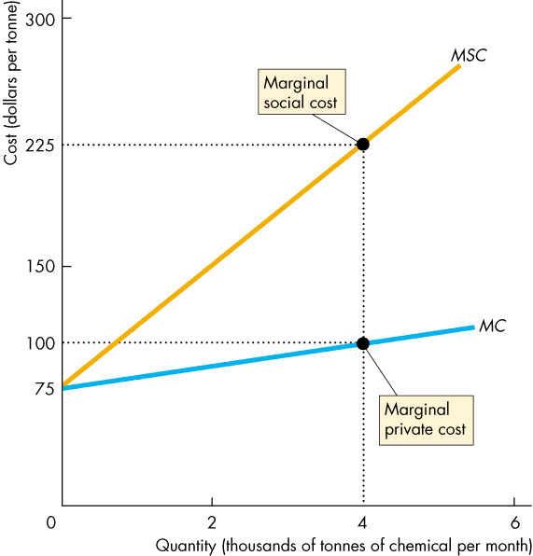
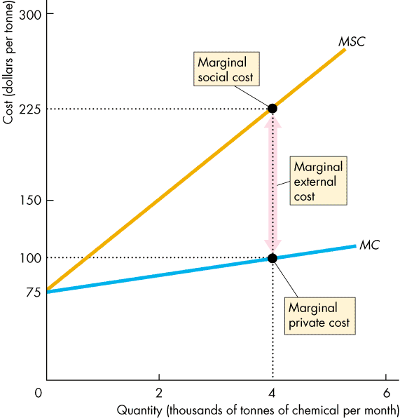
Negative Externality: Pollution
  External Cost and Output
  The figure illustrates the MC curve, …
  the MSC curve, …
  and marginal external cost as the vertical distance between the MC and MSC curves.
Copyright © 2013 Pearson Canada Inc., Toronto, Ontario

Slide 14
Negative Externality: Pollution
Production and Pollution: How Much?
  In the market for a good with an externality that is unregulated, the amount of pollution created depends on the equilibrium quantity of the good produced.
Copyright © 2013 Pearson Canada Inc., Toronto, Ontario

Slide 15
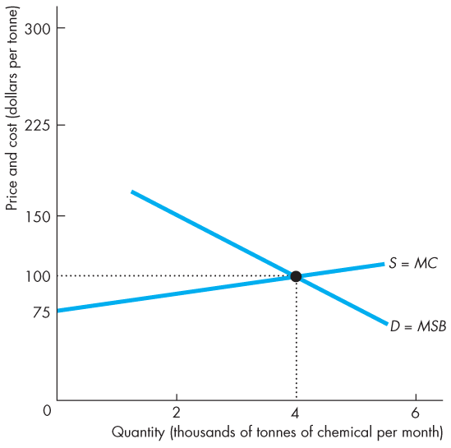
Negative Externality: Pollution
  The figure shows the equilibrium in an unregulated market with an external cost.
  The quantity of the good produced is where marginal private cost (MC) equals marginal social benefit (MSB).
Copyright © 2013 Pearson Canada Inc., Toronto, Ontario

Slide 16
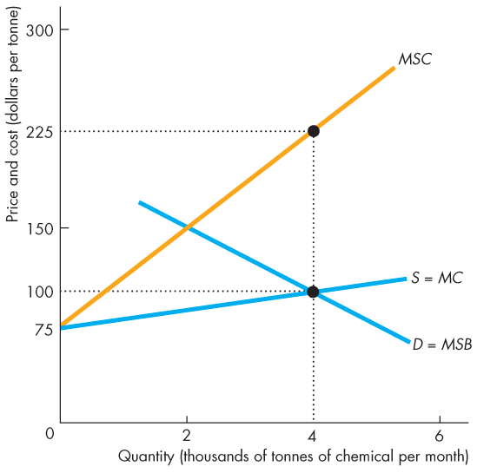
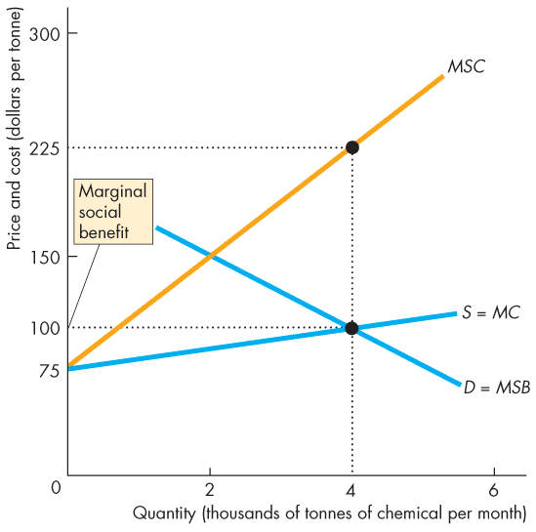
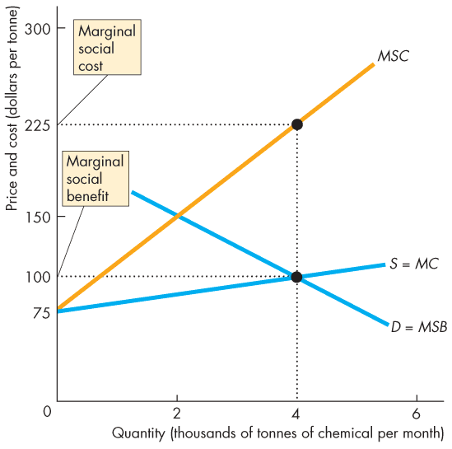
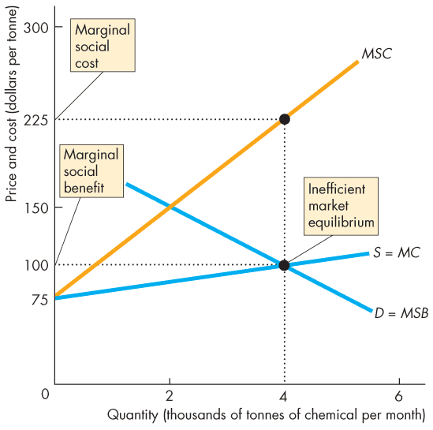
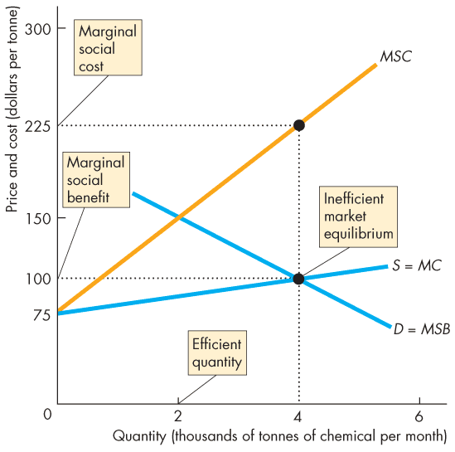
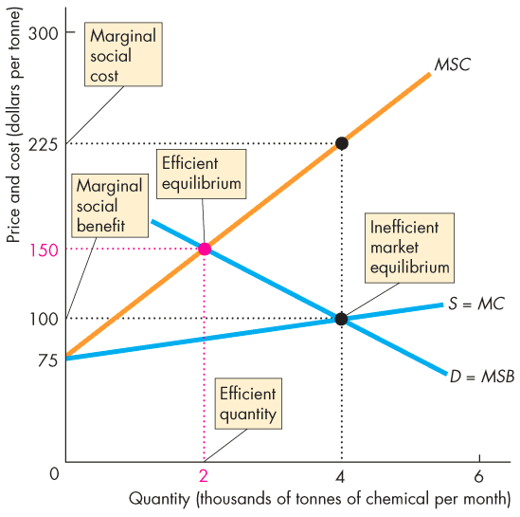
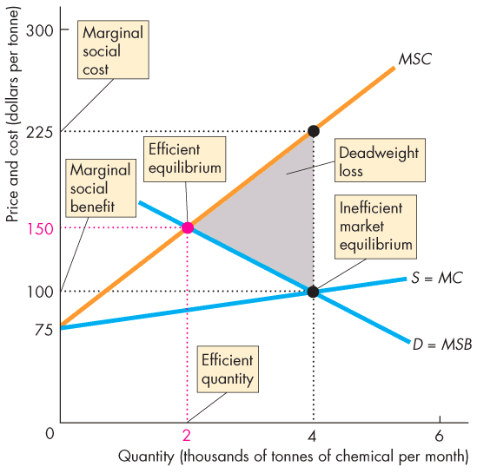
Negative Externality: Pollution
  At the market equilibrium, MSB is less than MSC, so the market produces an inefficient quantity of the good.
  At the efficient quantity of the good, MSC = MSB.
  With no regulation, the market produces too much of the good and creates a deadweight loss.
Copyright © 2013 Pearson Canada Inc., Toronto, Ontario

Slide 17
Negative Externality: Pollution
Is society doomed to live with this inefficiency? No.
Government can step in to solve an externality problem and arrive at an efficient equilibrium.
Copyright © 2013 Pearson Canada Inc., Toronto, Ontario

Slide 18
Negative Externality: Pollution
Government Actions in a Market with External Costs
  Externality fixes come in two basic types: those that work through their effect on price (taxes and emission charges) and those that work through their effect on quantity (cap and trade)
  We will focus on how taxes work to achieve efficiency in markets with negative externalities.
Copyright © 2013 Pearson Canada Inc., Toronto, Ontario

Slide 19
Negative Externality: Pollution
  Taxes
  The government can set a tax equal to marginal external cost.
  The effect of such a tax is to make marginal private cost plus the tax equal to marginal social cost,
  MC + tax = MSC.
  This tax is called Pigouvian tax, in honor of the British economist Arthur Cecil Pigou, who first proposed dealing with externalities in this fashion.
Copyright © 2013 Pearson Canada Inc., Toronto, Ontario

Slide 20
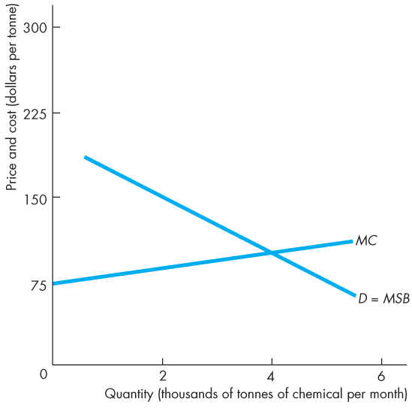
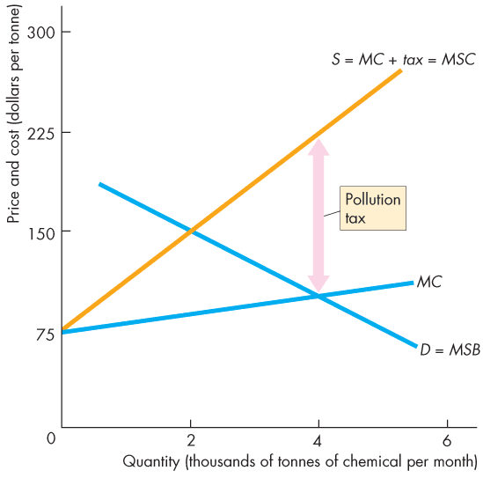
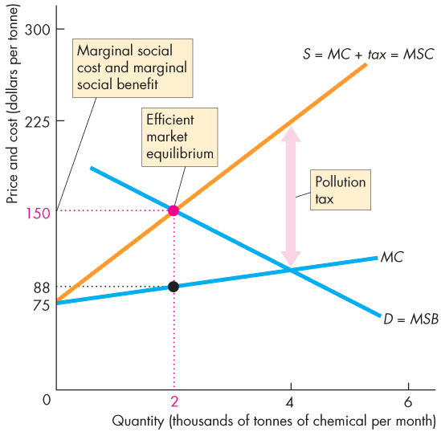
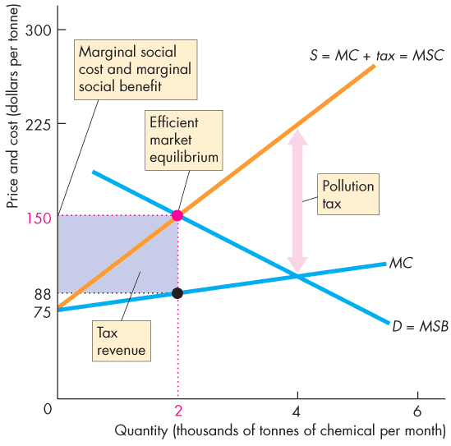
Negative Externality: Pollution
  The figure shows how a pollution tax equal to the marginal external cost can achieve an efficient outcome.
  At the quantity of the good produced, MSC = MSB.
  The government collects a tax revenue.
Copyright © 2013 Pearson Canada Inc., Toronto, Ontario

Slide 21
Positive Externality: Knowledge
  Knowledge comes from education and research and creates external benefits.
Private Benefits and Social Benefits
  A private benefit is a benefit that the consumer of a good or service receives, and marginal private benefit (MB) is the private benefit from consuming one more unit of a good or service.
  An external benefit is a benefit that someone other than the consumer receives. Marginal external benefit is the benefit from consuming one more unit of a good or service that people other than the consumer enjoy.
Copyright © 2013 Pearson Canada Inc., Toronto, Ontario

Slide 22
Positive Externality: Knowledge
  Marginal social benefit is the marginal benefit enjoyed by the entire society—by the consumer and by everyone else on whom the benefit falls.
  Marginal social benefit is the sum of marginal private benefit and marginal external benefit. That is:
  MSB = MB + Marginal external benefit.
Copyright © 2013 Pearson Canada Inc., Toronto, Ontario

Slide 23
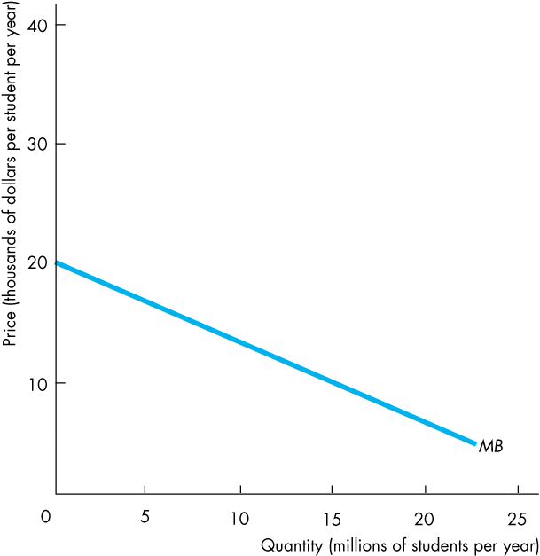
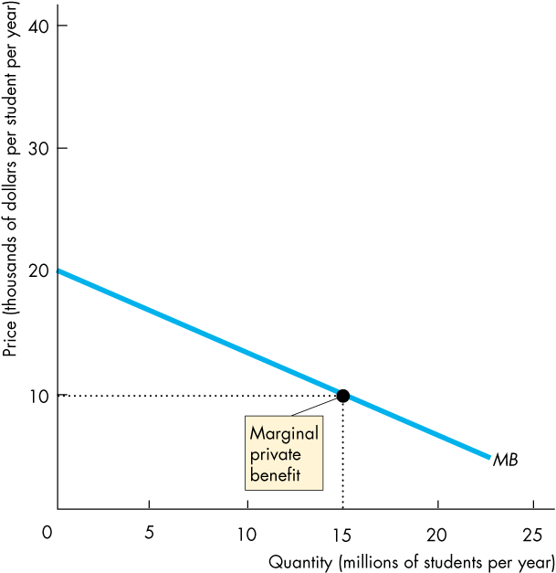
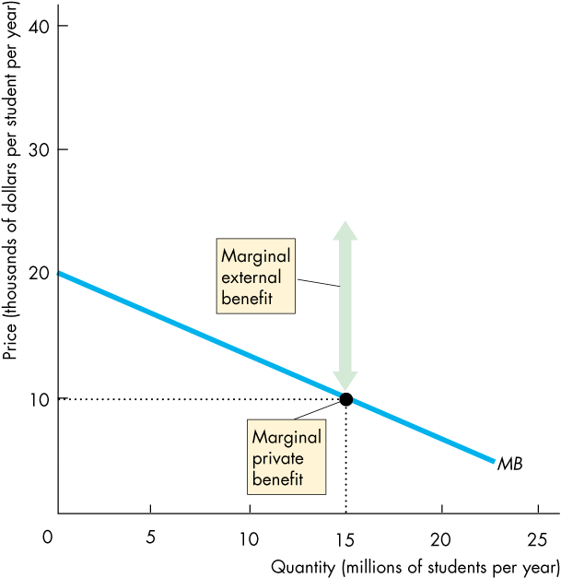
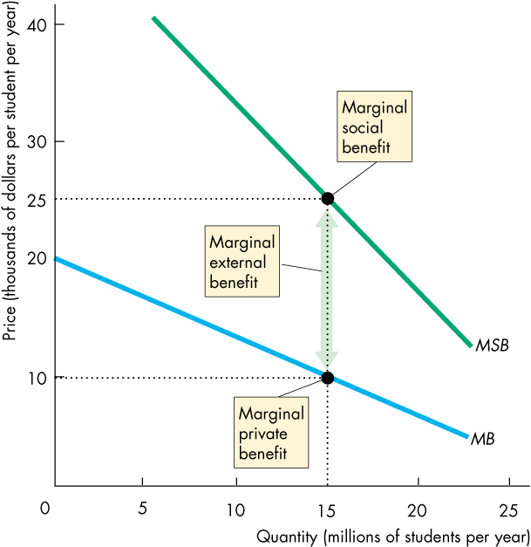
Positive Externality: Knowledge
  The figure illustrates the marginal private benefit, …
  marginal external benefit, …
  and marginal social benefit.
  It identifies marginal external benefit as the vertical distance between the MB and MSB curves.
Copyright © 2013 Pearson Canada Inc., Toronto, Ontario

Slide 24
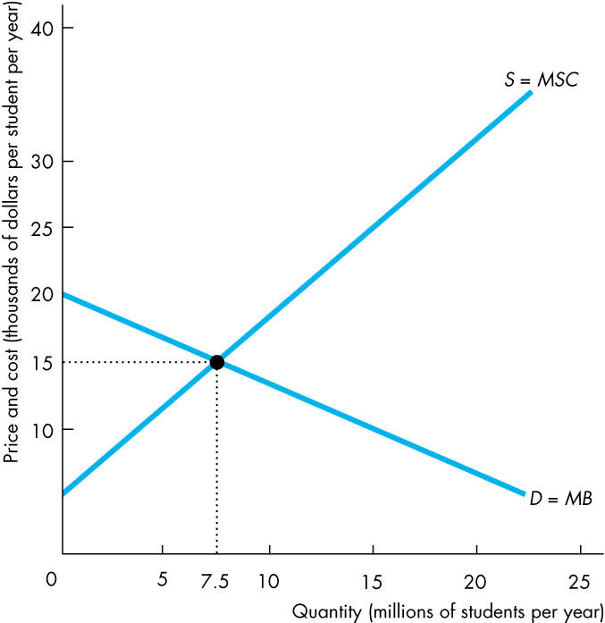
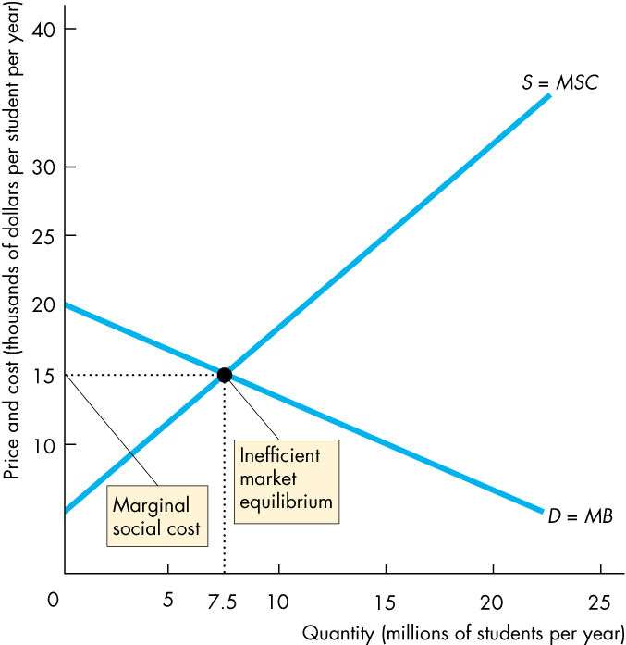
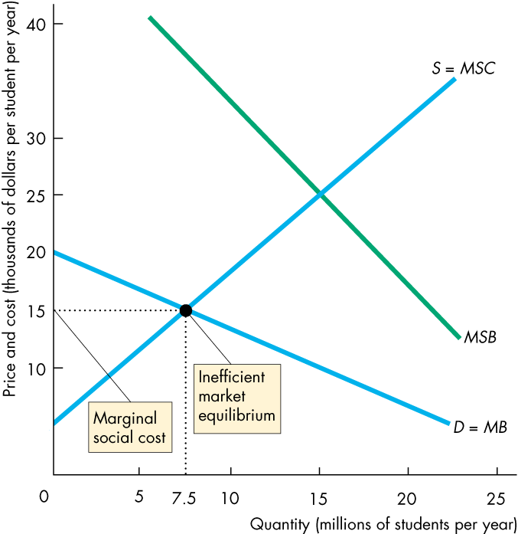
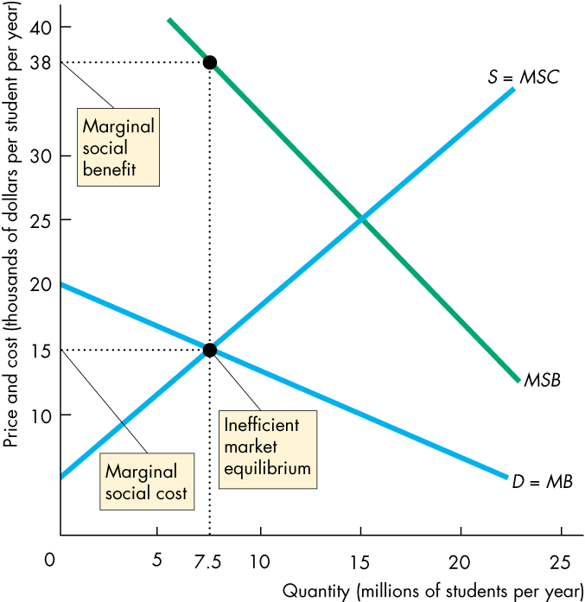
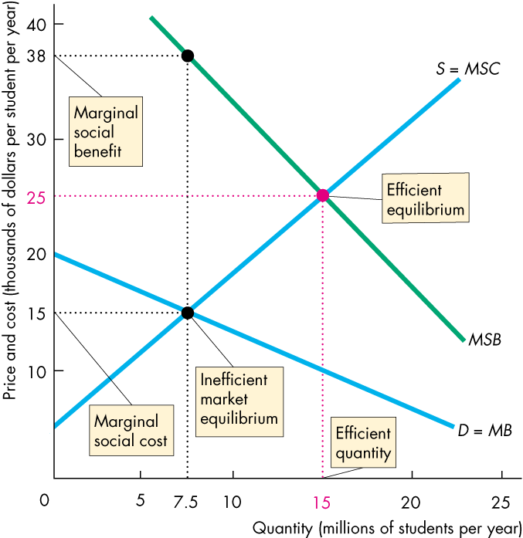
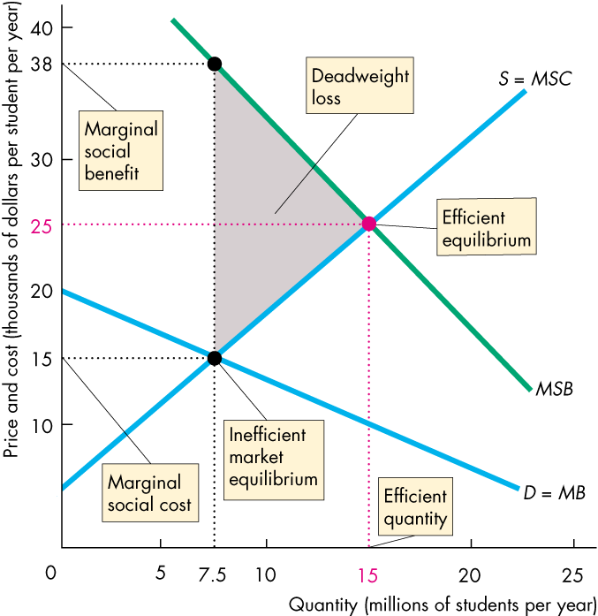
Positive Externality: Knowledge
  The figure shows how a private market underproduces an item that generates an external benefit …
  and creates a deadweight loss.
Copyright © 2013 Pearson Canada Inc., Toronto, Ontario

Slide 25
Positive Externality: Knowledge
Government Action in the Face of External Benefits
  The most common devices used by government to achieve a more efficient allocation of resources in the presence of external benefits are public production, private subsidies, and patents and copyrights (other devices include vouchers).
  We will focus on how private subsidies work to achieve efficiency in markets with positive externalities.
Copyright © 2013 Pearson Canada Inc., Toronto, Ontario

Slide 26
Positive Externality: Knowledge
  Private Subsidies
  A subsidy is a payment by the government to private producers.
  If the government pays the producer an amount equal to the marginal external benefit at the efficient quantity, the market outcome will be efficient.
Copyright © 2013 Pearson Canada Inc., Toronto, Ontario

Slide 27
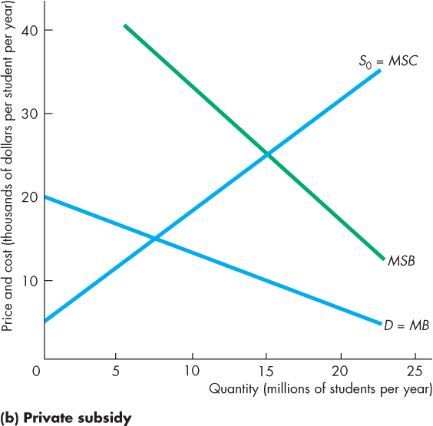
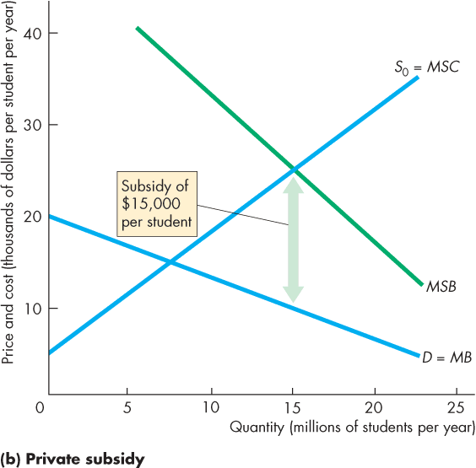
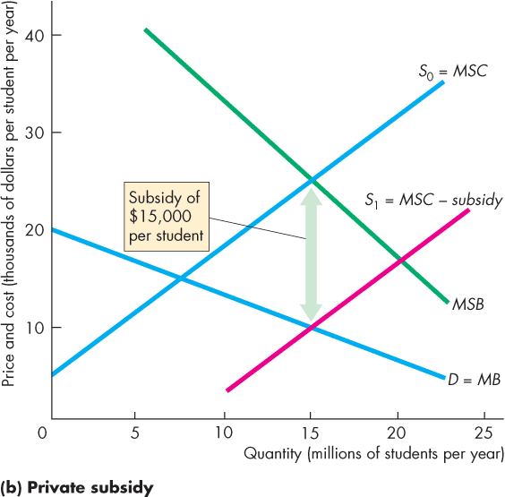
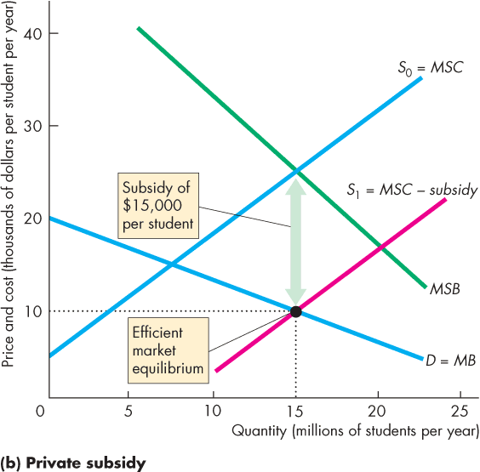
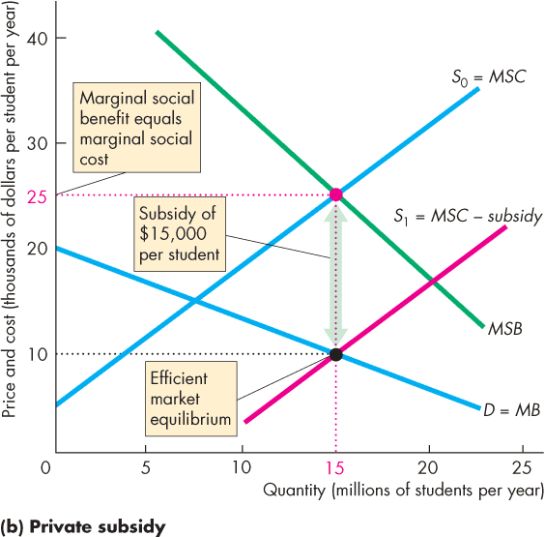
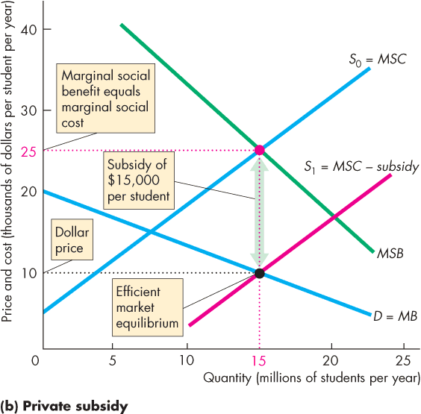
Positive Externality: Knowledge
  The figure shows how a subsidy can achieve an efficient outcome.
Copyright © 2013 Pearson Canada Inc., Toronto, Ontario

